Slide 1

Employee Talent Management
DDS Analytics
Aug 15, 2019

Slide 2
Agenda
Overview
Exploratory Data Analysis
Variable Summary Statistics
Employee Turnover Factors
Model Review
Summary

Slide 3
Overview
To identify the factors that lead to attrition
To visualize the job specific trends in the underlying dataset
To highlight the key take away from the analysis
To create a model to successfully predict the Employee Attrition and salary
To help management develop employee retention strategies

Slide 4
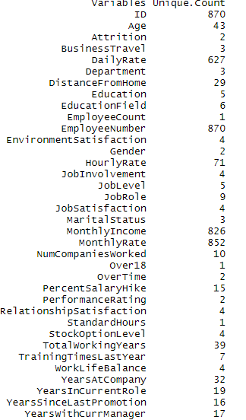
Exploratory Data Analysis
The Employee dataset(CaseStudy2.csv) used for analysis was provided in csv format with 36 columns and 870 rows.
The Employee dataset(CaseStudy2CompSet No Attrition.csv) used for attrition prediction had 35 columns and 300 rows
The Employee dataset(CaseStudy2CompSet No Salary.csv) used for salary prediction had 35 columns and 300 rows
There were no nulls in the provided dataset
Unique values per column

Slide 5
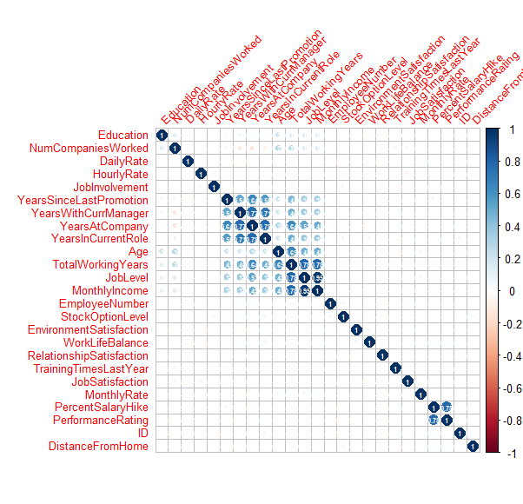
Exploratory Data Analysis
Correlation plot

Slide 6
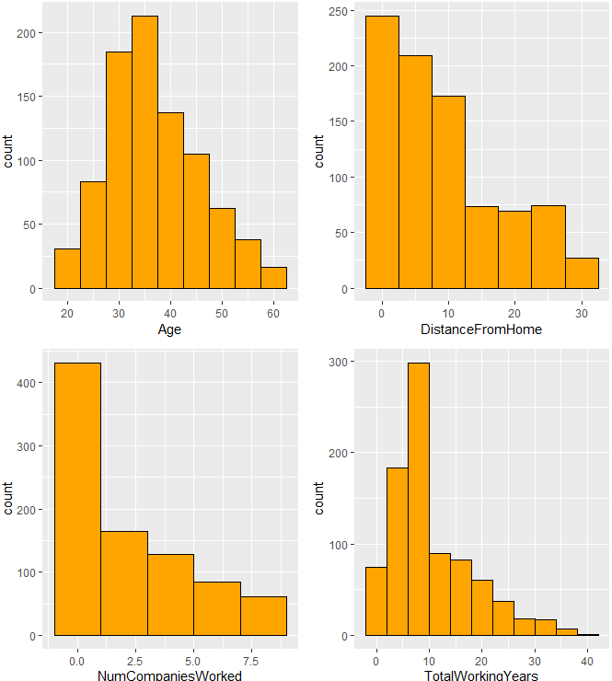
Exploratory Data Analysis
Age is almost normally distributed
Right skewness in distance from home, number of companies, total working years

Slide 7
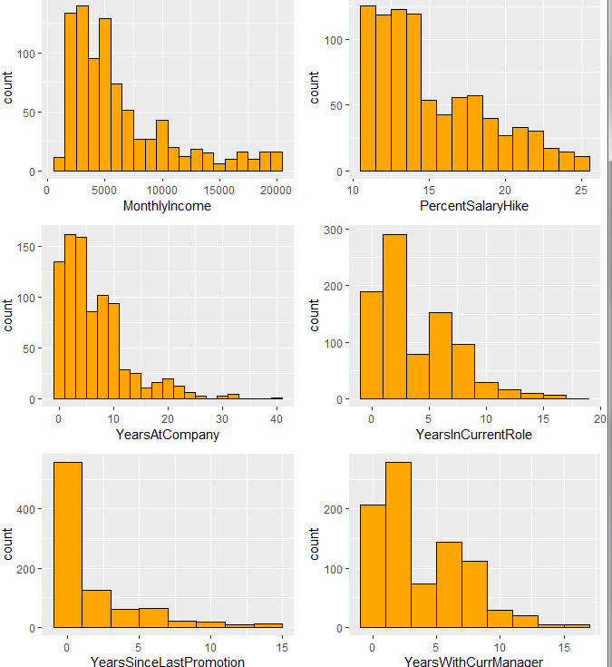
Exploratory Data Analysis
Right Skewness in Monthly Income,
Percent Salary Hike, Years at Company, Years in Current Job Role, Years since last promotion , Years with Current manager

Slide 8
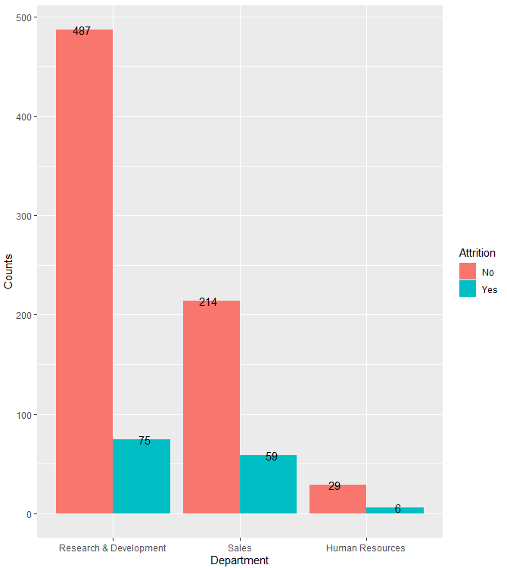
Exploratory Data Analysis
More than 50% of the employees work in
Research & Development

Slide 9
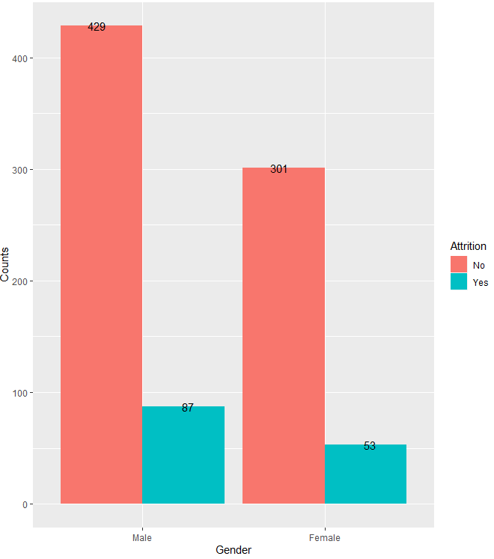
Exploratory Data Analysis
More than 50% of the workforce is male

Slide 10
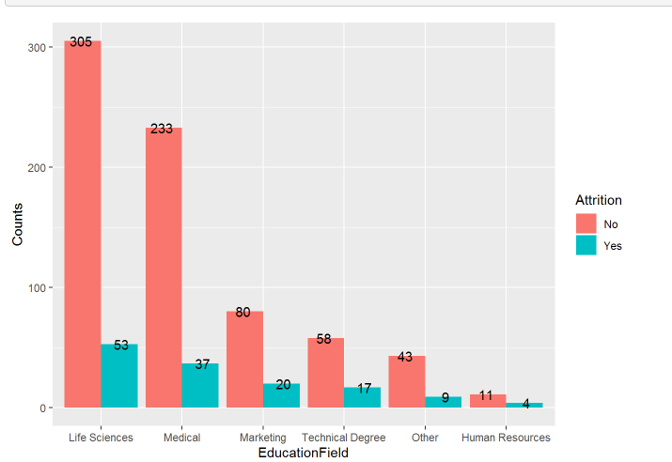
Exploratory Data Analysis
More than 75 % of the workforce belong to Life Science or Medical field

Slide 11
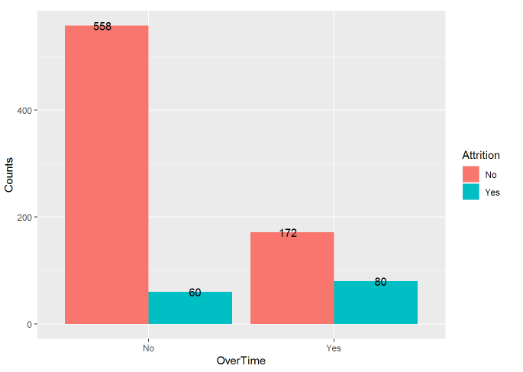
Exploratory Data Analysis
More than 70 % of the people do overtime

Slide 12
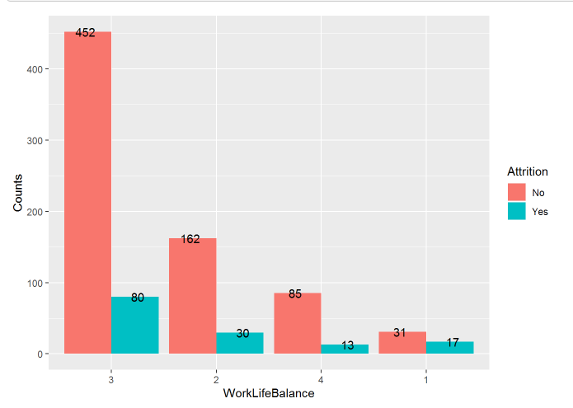
Exploratory Data Analysis
Almost 60% of people reported a better work life balance

Slide 13
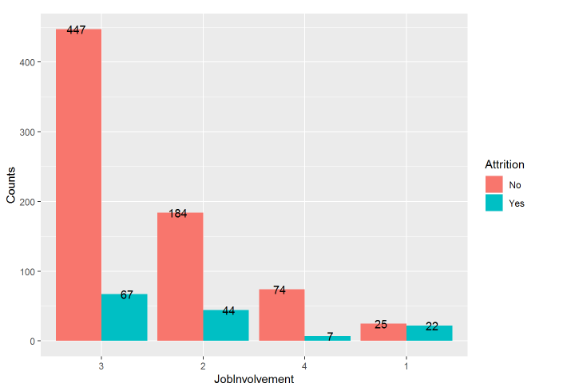
Exploratory Data Analysis
More than 50% of people believe they have more job involvement

Slide 14
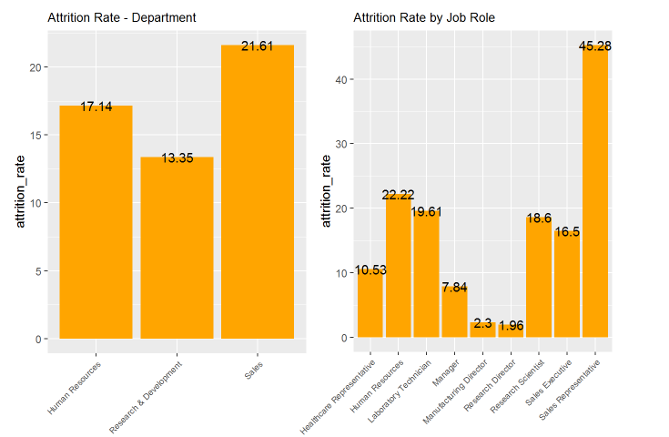
Exploratory Data Analysis
Attrition is higher in Sales employees

Slide 15
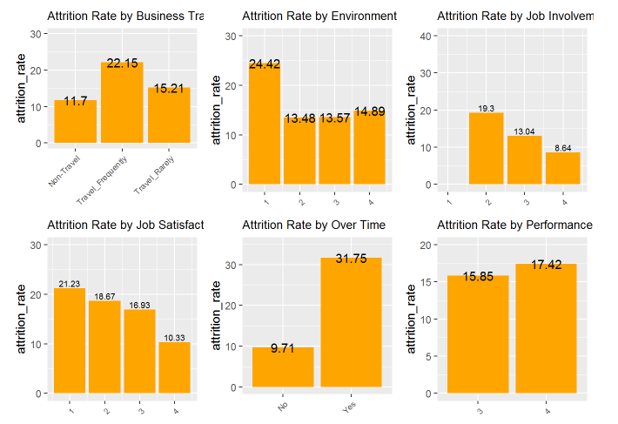
Exploratory Data Analysis
Attrition is higher amongst people
Who travel frequently or are over utilized. Also the Employees with low environment satisfaction tend to leave more.

Slide 16
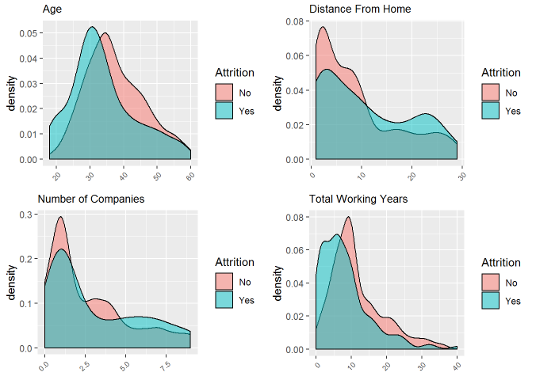
Exploratory Data Analysis
Attrition is more common in younger workforce compared to elderly.
Attrition also is influence by the distance from home , number of companies worked and Total working years.

Slide 17
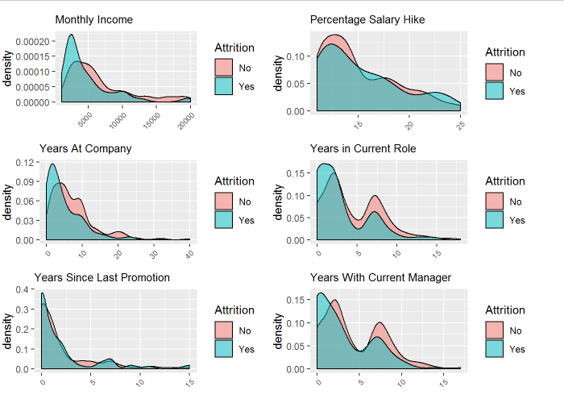
Exploratory Data Analysis
Attrition is higher amongst people
Who travel frequently or are over utilized. Also the Employees with low environment satisfaction tend to leave more.

Slide 18
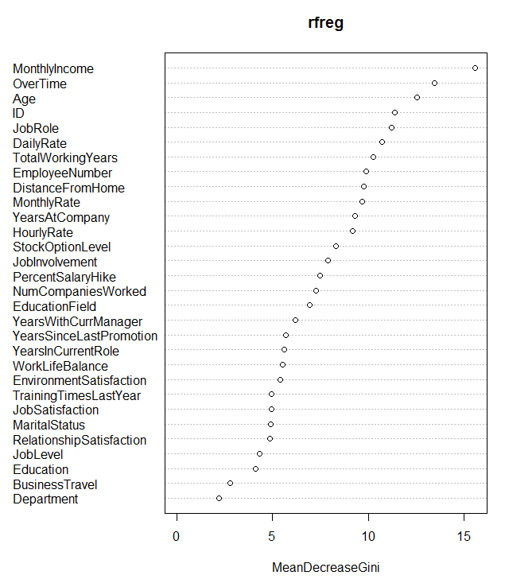
Exploratory Data Analysis
Consolidating the Exploratory variables and categorical variable analysis here are the top influencers of attrition

Slide 19
Data Preparation and Building Model
Dataset was normalized and split into training and test samples
With split ratio of .75
The numerical data was run through the Random forest and the linear regression models
The categorical data was run though KNN and NB models

Slide 20
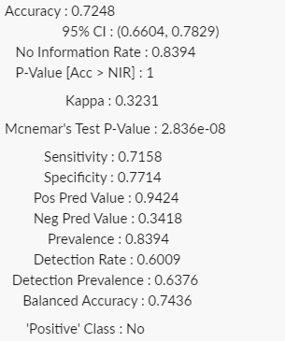
Data Preparation and Building Model
For classifying attrition KNN and NB models were chosen
KNN Sensitivity/Specificity Metrics

Slide 21
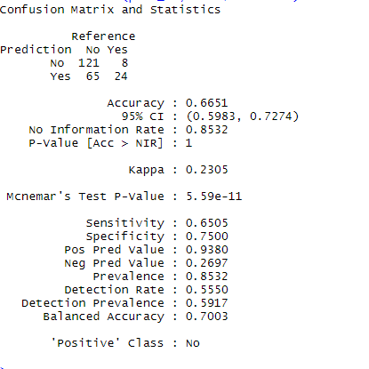
Data Preparation and Building Model
NB confusion Matrix

Slide 22
Data Preparation and Building Model
For the Monthly salary prediction , Linear regression model (log transformed data) and random forest were chosen
Here are the metrics for the linear regression model
ASE = 1.06
RMSE = 1.27
The predicted monthly salary and attrition outputs have been generated

Slide 23
Conclusion
A complete EDA was performed on the provided dataset
The parameter were plugged into the models and models fine tuned to meet the benchmarks of specific/sensitivity 60/60 and RMSE<$3000
The exploratory analysis of the data provided key insight to key factors influencing attrition and can be used by the management for future retention strategies.

Slide 24
Reference
https://github.com/nehadixit25/CaseStudy2DDS

Slide 25
Thank You!

